Slide 1
Huff Research Group Kendra Andersen
Group Meeting 11/13/17

Slide 2
Project Description
Navigation in Radio Frequency Landscapes using Autonomous Vehicles and Multiple Antenna Systems
Collect data on signal strength of various antenna systems using autonomous rovers.
Develop algorithm to plan a route for the rover which maximizes received signal strength (RSS).
Develop control strategy to examine signal strength at various frequencies for a GPS location and determine the best antenna configuration to maximize RSS.

Slide 3
Status
Last Week:
Coming up:
Created a procedure document for starting up the rovers.
Path optimization to maximize the SNR.
Thesis Formatting Workshop
First Thesis Installment Approved
Continue algorithm development to broaden its scope.
Update the path-planning algorithm to use real data and to determine optimal paths in real-time.
Assist Ryan in collecting data.

Slide 4
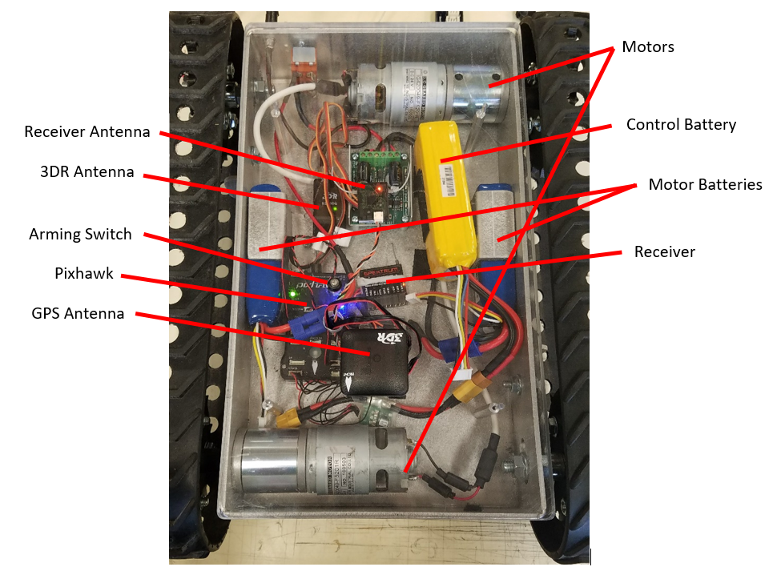
Data Collection Setup on the Autonomous Rover
Created a procedure document for how to set it up, for anyone else who may end up running it.

Slide 5
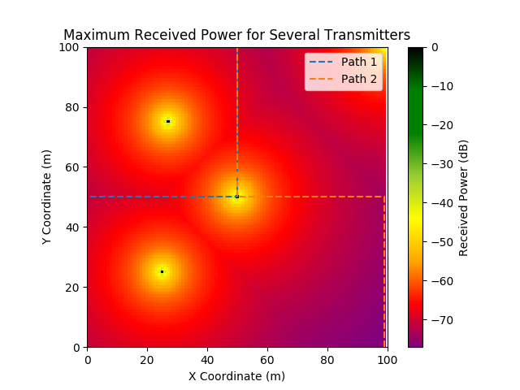
Findings/Progress
Sample output:
Path 1 maximizes received power from the transmitter at [25, 25]
For good transmitter [27, 75] and bad transmitter [50, 50],
Path 1 maximizes the ratio of good/bad received power.

Slide 6
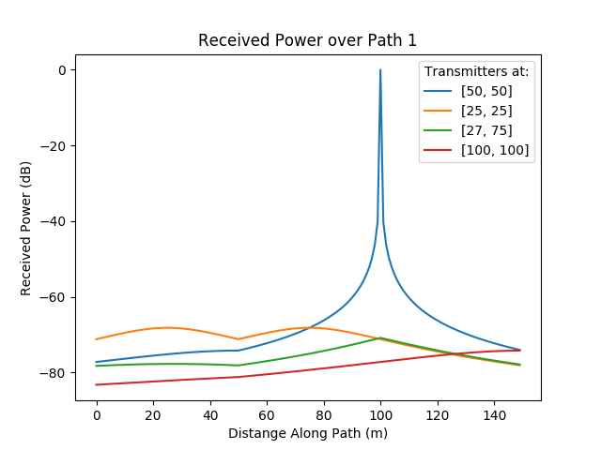
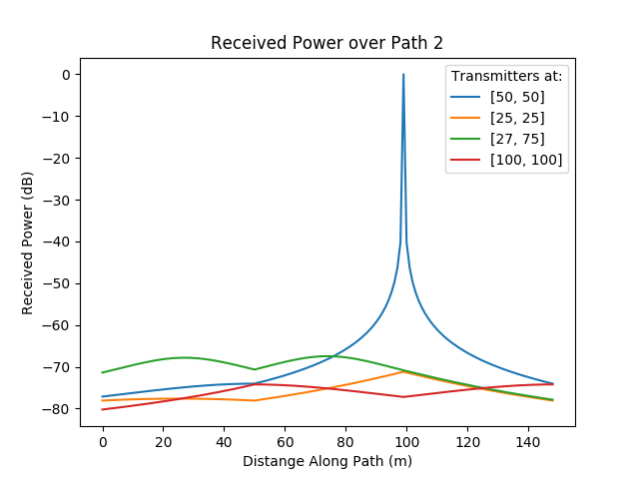
Findings/Progress

Slide 7
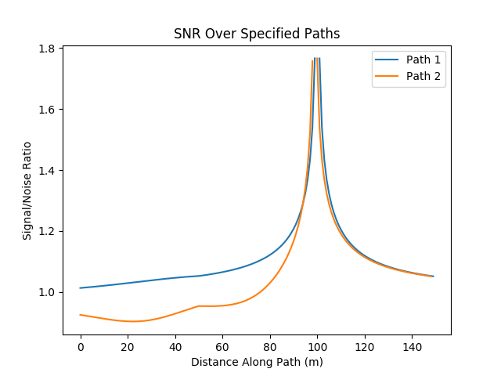
Findings/Progress
For good transmitter [27, 75] and bad transmitter [50, 50]:

